Slide 1

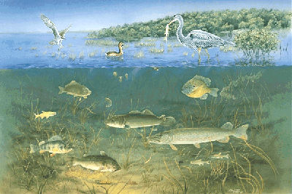
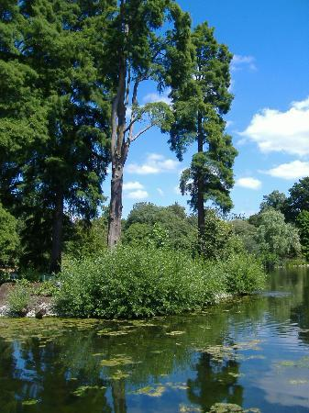

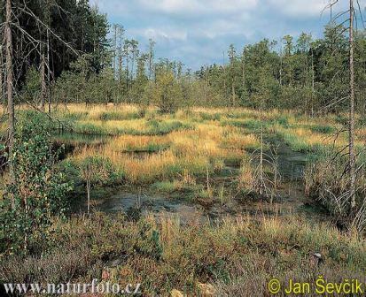
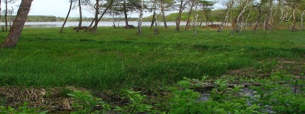
Wetlands
What are the most common wetlands and what sets them apart from each other?

Slide 2
Wetlands
Wetlands are the areas with water at the surface or in the root zone, they have unique soil and vegetation that adapted to water
They are important wildlife habitats
In Alberta they support over 250 species of birds, 42 species of mammals, 22 species of fish and many plants
Western and Aboriginal scientists classify wetlands using different categories

Slide 3
Western Science
Classifies wetlands by:
  How much water is in them
  How long the water stays around
  What kinds of plants and animals are in and around them
  What kind of soil is present
Suggests that there are 5 different types of wetlands in Alberta
Wetlands act as “nature’s kidneys” as they clean and filter water

Slide 4
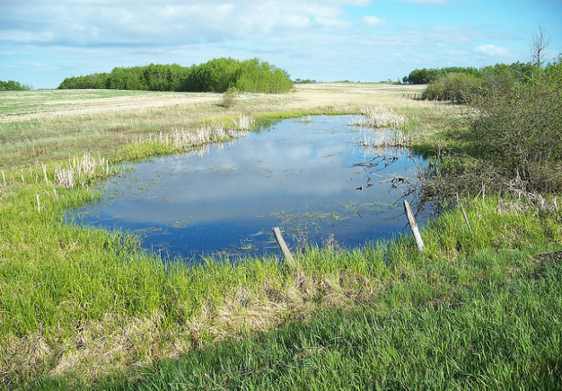

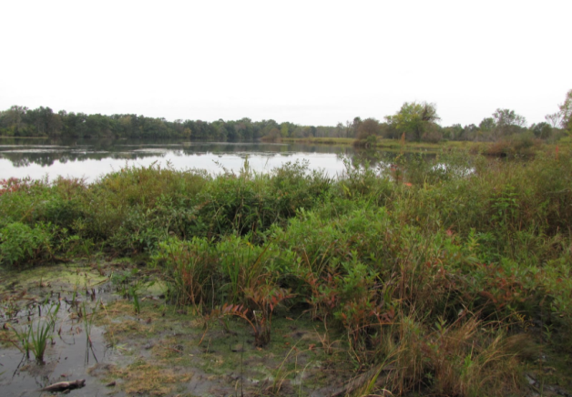
Swamp
A shallow depression or low spot on the floodplains that contains slowly moving water.
Shallow Pond
open water, may dry in late summer
Bog
no water

Slide 5
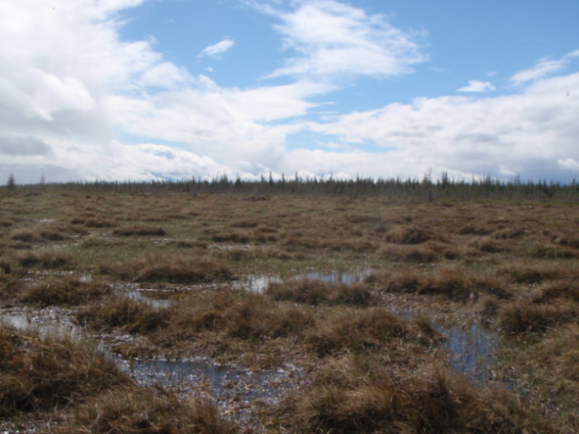
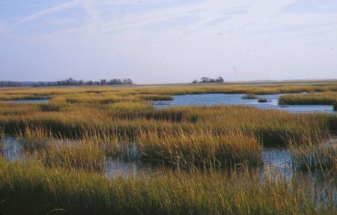
Fen
Water at the surface or just below
Marsh
Water run-off, rain or snow, and groundwater with high water but not trees, with cattails, rushes and sedges

Slide 6
In these five types of wetlands:
Water levels are different in each type
Species are different in each one
Bogs and fens have peat layers in them
Fens are what we mostly have in the north of Alberta

Slide 7
Aboriginal Science
Classifies wetlands by:
  Whether or not they provide drinkable water
  Their quality as a harvesting site for animals and their function as a place of rest for animals
  What plants can be harvested from the area (such as medicine, roots and food)
  How easy it is to travel through them
  Whether they have cultural significance; as a swimming hole, meeting place or gathering site
Wetlands act as a meeting spot for animals and a good harvesting spot for the fall hunt

Slide 8
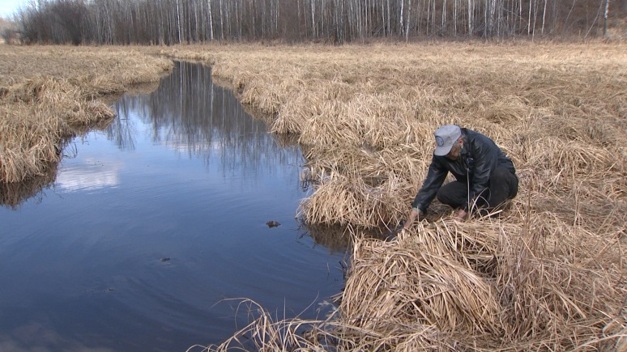
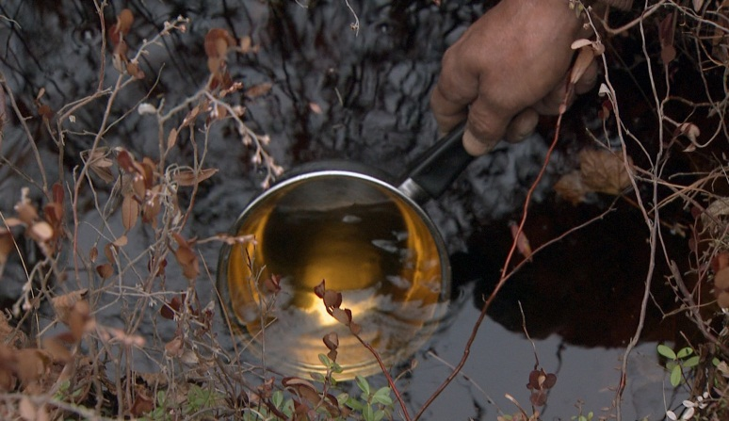
Drinkable water
Water travels through a variety of filters before it is in the muskeg
It is slightly brown
It makes good tea water
Muskeg water is pure and makes good medicine water
It is seen as a gift from the Creator

Slide 9
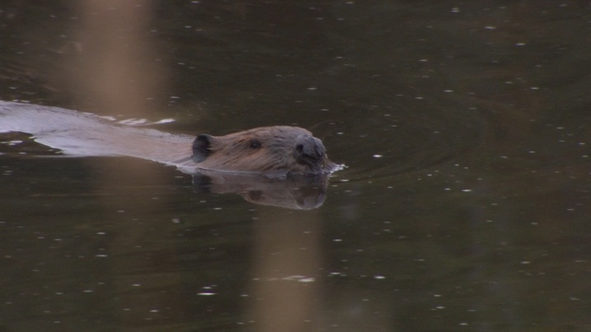
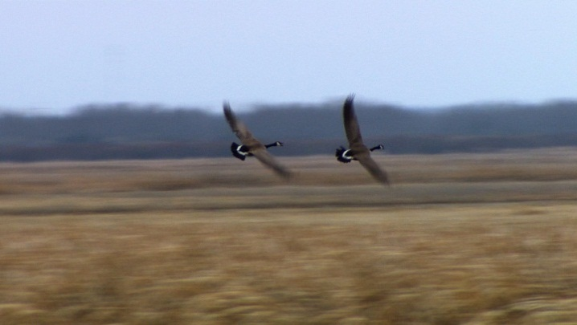
Harvesting site and
place of refuge for animals
A wetland may be known for the quality of harvesting as well as the number and variety of animals that travel to it
It may be known for the service it provides to animals—a refuge, a home, a place to drink

Slide 10
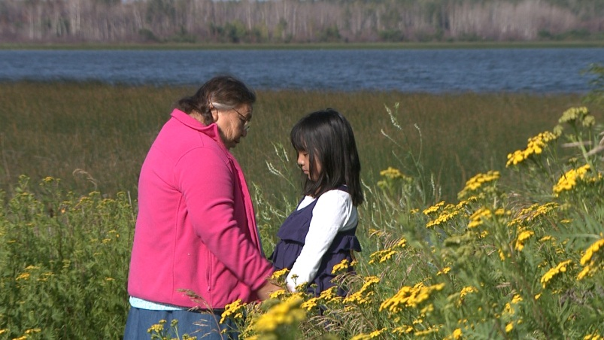
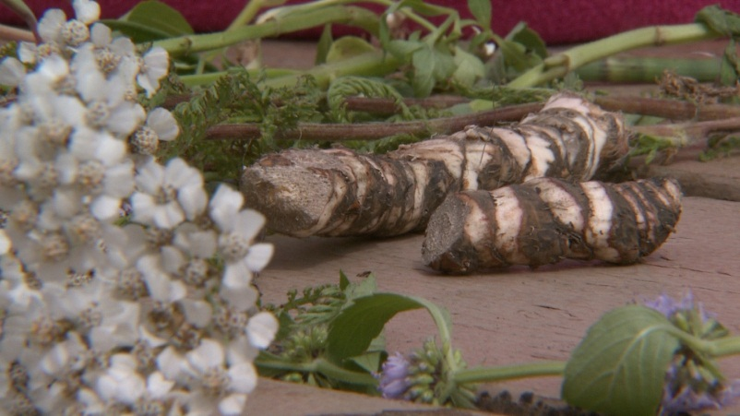
Harvesting site for medicines, food, herbs
Different types of wetlands are host to different medicines that are useful for illnesses
People are able to avoid the harmful things in a plant and treat an illness with the useful part
An offering is always made to the plant in thanks for the useful medicine

